Slide 1
Database System
Textbook: Database System Concepts (6th Edition)
Instructor : SUN Jianling(孙建伶) (Professor)
Office:Yi-Fu Gong Shang Building 234
(逸夫工商管理楼234)
Yu Quan Campus (玉泉校区)
Email: sunjl@zju.edu.cn
Tel: 87952700, 13705818519
wechat: sobeksun
Course TA :卢涛（Master Student)
Email: 3140102441@zju.edu.cn
Tel: 13676632069
wechat: LuTao-TT

Slide 2
Database System
Course Grading Policy:
  Exercise 10%
  Quiz 10%
  Lab & Project 30%
  Exam 50%
  (Open two-page notes, handwriting, with student ID & name)

Slide 3
Database System
Course URL:
  course.zju.edu.cn/course/13617
  Wechat: 2020春夏数据库系统

Slide 4
Database System in CS
AI 、 CAD&CG、Multimedia、e-commerence、 Numerical Analysis、Software Engine、Embedded System
C、C++、Java、Data Structure、Algorithm
Complier、Database System、Network
Operating System
Computer Organization、Computer Architecture、Assemble
Circuit、Digital circuit

Slide 5

database = data base
database – 数据库
data warehouse – 数据仓库
data base → 数据基地

Slide 6
Chapter 1: Introduction

Slide 7
Outline
Database Systems
Database Applications
Purpose of Database Systems
View of Data
Data Models
Database Languages
Database Design
Database Engine
Database Users and Administrators
History of Database Systems

Slide 8
Database Systems
Database System contains information about a particular enterprise
  Collection of interrelated data
  Set of programs to access the data
  An environment that is both convenient and efficient to use
DBMS - Database Management System
Database systems are used to manage collections of data that are:
  Highly valuable
  Relatively large
  Accessed by multiple users and applications, often at the same time.

Slide 9
Database Applications
Database Applications（数据库应用，数据库应用系统）:
  Banking: transactions
  Universities: registration, grades
  Airlines: reservations, schedules
  Sales: customers, products, purchases
  Online retailers: order tracking, customized recommendations
  Manufacturing: production, inventory, orders, supply chain
  Human resources: employee records, salaries, tax deductions
Databases can be very large. →big data
Databases touch all aspects of our lives

Slide 10

Database Example-Banking
Application program example - Banking
  Add customers
  Open accounts
  Save/Withdraw money
  Lend/ Repay loans

Slide 11

Database Example- University
Application program example - University
  Add new students, instructors, and courses
  Register students for courses, and generate class rosters
  Assign grades to students
  compute grade point averages (GPA) and generate transcripts

Slide 12
Purpose of Database Systems
In the early days, database applications were built directly on top of file systems，which leads to:
  Data redundancy（数据冗余） and inconsistency（不一致）
    Multiple file formats, duplication of information in different files
  Data isolation（数据孤立，数据孤岛） — multiple files and formats
  Difficulty in accessing data （存取数据困难）
    Need to write a new program to carry out each new task

Slide 13
Purpose of Database Systems
  Integrity problems（完整性问题）
    Integrity constraints become “buried” in program code rather than being stated explicitly(显式的)
    Example: “account balance >=1”
    Hard to add new constraints or change existing ones

Slide 14
Purpose of Database Systems
  Atomicity problems（原子性问题）
    Failures may leave database in an inconsistent state with partial updates carried out
    Example: Transfer of funds from one account to another should either complete or not happen at all
50
A：100
B：100
balance - 50
balance + 50

Slide 15
Purpose of Database Systems
  Concurrent access anomalies（并发访问异常）
    Concurrent access needed for performance
    Uncontrolled concurrent accesses can lead to inconsistencies
    Example: Two people reading a balance (say 100) and updating it by saving money (say 50 each) at the same time
T1
T2
read : balance = 100
read: balance = 100
write : balance +50
write : balance + 50
A：100

Slide 16
Purpose of Database Systems
  Security problems（安全性问题）
    Hard to provide user access to some, but not all, data
    Authentication(认证）
    Priviledge （权限）
    Audit（审计）
Database systems offer solutions to all the above problems

Slide 17
Characteristics of Databases
Characteristics of Databases
  data persistence(数据持久性)
  convenience in accessing data(数据访问便利性)
  data integrity （数据完整性）
  concurrency control for multiple user(多用户并发控制)
  failure recovery（故障恢复）
  security control（安全控制）

Slide 18

View of Data
An architecture for a database system
view/logical
mapping
logical/physical
mapping

Slide 19
Schema and Instance
Similar to types and variables in programming languages
Schema （模式）– the logical structure of the database
  Example: The database consists of information about a set of customers and accounts and the relationship between them
  Analogous to type information of a variable in a program
  Physical schema（物理模式）: database design at the physical level
  Logical schema（逻辑模式）: database design at the logical level
Instance（实例） – the actual content of the database at a particular point in time
  Analogous to the value of a variable

Slide 20
Data Independence
Physical Data Independence（物理数据独立性） – the ability to modify the physical schema without changing the logical schema
  Applications depend on the logical schema
  In general, the interfaces between the various levels and components should be well defined so that changes in some parts do not seriously influence others.
  Logical Data Independence(逻辑数据独立性) – the ability to modify the logical schema without changing the user view schema

Slide 21
Data Models（数据模型）
A collection of tools for describing
  Data (数据)
  Data relationships(联系)
  Data semantics(语义)
  Data constraints(约束)
Relational model(关系模型)
Entity-Relationship(实体-联系) data model
Object-based data models
  Object-oriented (面向对象数据模型)
  Object-relational(对象-关系模型模型)
Semistructured data model (XML)(半结构化数据模型)
Other older models:
  Network model (网状模型)
  Hierarchical model(层次模型)

Slide 22
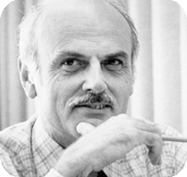
Relational Model
Relational model (Chapter 2，chapter 6)
Example of tabular data in the relational model
Columns / Attributes
(列/属性)
Rows / Tuples
（行/元组）
Ted Codd
Turing Award 1981

Slide 23
A Sample Relational Database

Slide 24
Data Definition Language (DDL)
（数据定义语言）
Specification notation for defining the database schema
  Example: create table instructor (
  ID char(5),
  name varchar(20),
  dept_name varchar(20),
  salary numeric(8,2))
DDL compiler generates a set of table templates stored in a data dictionary（数据字典）
Data dictionary contains metadata (元数据， i.e., data about data)
  Database schema
  Integrity constraints（完整性约束）
    Primary key (ID uniquely identifies instructors)（主健）
    Referential integrity (references constraint in SQL)（参照完整性）
      e.g. dept_name value in any instructor tuple must appear in department relation
  Authorization（权限）

Slide 25
Data Manipulation Language (DML)
（数据操作语言）
Language for accessing and manipulating the data organized by the appropriate data model
  DML also known as query language
Two classes of languages
  Procedural（过程式） – user specifies what data is required and how to get those data
  Declarative (nonprocedural， 陈述式，非过程式) – user specifies what data is required without specifying how to get those data
SQL is the most widely used query language

Slide 26
SQL Query Language
SQL: widely used non-procedural language
  Example: Find the name of the instructor with ID 22222
  select name
  from instructor
  where instructor.ID = ‘22222’
  Example: Find the ID and building of instructors in the Physics dept.
  select instructor.ID, department.building
  from instructor, department
  where instructor.dept_name = department.dept_name and
  department.dept_name = ‘Physics’
Application programs generally access databases through one of
  Language extensions to allow embedded SQL
  API（Application program interface） (e.g., ODBC/JDBC) which allow SQL queries to be sent to a database
Chapters 3, 4 and 5

Slide 27
Database Access from Application Program
Non-procedural query languages such as SQL are not as powerful as a universal Turing machine.
SQL does not support actions such as input from users, output to displays, or communication over the network.
Such computations and actions must be written in a host language, such as C/C++, Java or Python, with embedded SQL queries that access the data in the database.
Application programs -- are programs that are used to interact with the database in this fashion.

Slide 28


Database Design(数据库设计)
Entity Relationship Model （实体-联系模型）(Chapter 7)
  Models an enterprise as a collection of data entities and relationships
  Represented diagrammatically by an entity-relationship diagram.
Normalization Theory（规范化理论） (Chapter 8)
  Formalize what designs are bad, and test for them
Is there any problem with this design?

Slide 29

Database Engine(数据库引擎)
A database system(database engine) is partitioned into modules that deal with each of the responsibilities of the overall system.
The functional components of a database system can be divided into
  The storage manager,
  The query processor component,
  The transaction management component.

Slide 30
Storage Manager
A program module that provides the interface between the low-level data stored in the database and the application programs and queries submitted to the system.
The storage manager is responsible to the following tasks:
  Interaction with the OS file manager
  Efficient storing, retrieving and updating of data
The storage manager components include:
  Authorization and integrity manager
  Transaction manager
  File manager
  Buffer manager

Slide 31
Storage Manager (Cont.)
The storage manager implements several data structures as part of the physical system implementation:
  Data files -- store the database itself
  Data dictionary -- stores metadata about the structure of the database, in particular the schema of the database.
  Indices -- can provide fast access to data items. A database index provides pointers to those data items that hold a particular value.

Slide 32
Query Processor
The query processor components include:
  DDL interpreter -- interprets DDL statements and records the definitions in the data dictionary.
  DML compiler -- translates DML statements in a query language into an evaluation plan consisting of low-level instructions that the query evaluation engine understands.
    The DML compiler performs query optimization; that is, it picks the lowest cost evaluation plan from among the various alternatives.
  Query evaluation engine -- executes low-level instructions generated by the DML compiler.

Slide 33

Query Processing
1. Parsing and translation
2. Optimization
3. Evaluation

Slide 34
Transaction Management
A transaction is a collection of operations that performs a single logical function in a database application
Transaction-management component ensures that the database remains in a consistent (correct) state despite system failures (e.g., power failures and operating system crashes) and transaction failures.
Concurrency-control manager controls the interaction among the concurrent transactions, to ensure the consistency of the database.

Slide 35
Database Users
Naïve users
Banking, Airlines
Sales, Health …
Database application
Application programmer
ODBC, JDBC,
Hibernet …
API
Oracle, DB2, SQL Server, MySQL, Sybase
Postgres …
DBMS
DBA
Unix/Linux,
Windows,
Mac OS …
OS
Data Analyst
Database

Slide 36

Database Users
Database

Slide 37
Database Users
Users are differentiated by the way they expect to interact with
the system
Application programmers – interact with system through DML calls
Naïve users – invoke one of the permanent application programs that have been written previously
  Examples, people accessing database over the web, bank tellers, clerical staff
Database Administrator - Coordinates all the activities of the database system; the database administrator has a good understanding of the enterprise’s information resources and needs.

Slide 38
Database Administrator（DBA）
Database administrator's duties include:
  Schema definition
  Storage structure and access method definition
  Schema and physical organization modification
  Granting user authority to access the database
  Specifying integrity constraints
  Acting as liaison with users
  Monitoring performance and responding to changes in requirements

Slide 39
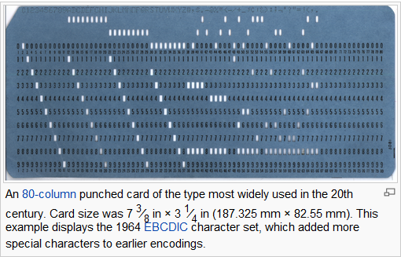
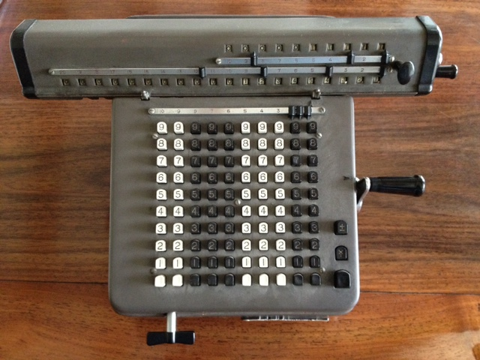
History of Database Systems
1950s and early 1960s:
  Data processing using magnetic tapes for storage
    Tapes provide only sequential access
  Punched cards for input

Slide 40
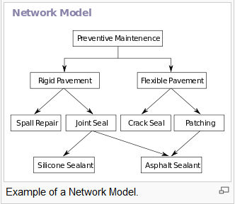
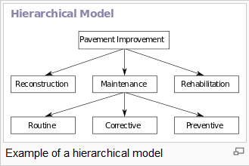
History of Database Systems
1960s :
  Hard disks allow direct access to data
  Network and hierarchical data models are widely used
  IDS（Integrated DataStore), 1961, GE
    Charles W. Bachman
  IBM IMS(Information Management System), 1968.

Slide 41
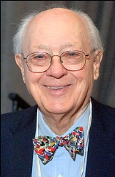
Turing Award:Charles W. Bachman(1924-)
  IDS（Integrated DataStore), 1961, GE(美国通用电气)
  1973 ACM Turing Award for his outstanding contribution to database technology
  In 1983, he founded Bachman Information Systems that developed a line of Computer-Aided Software Engineering (CASE) products.

Slide 42
History of Database Systems
1970s:
  Business Applications
    OLTP (Online Transaction Processing)
  Edgar F. Codd defines the relational data model
  IBM Research begins System R prototype(1974, Jim Gray as a key player)
  UC Berkeley begins Ingres prototype(1974, leaded by Michael Stonebraker)

Slide 43

Turing Award: Edgar F. Codd (1923-2003)
  A Relational Model of Data for Large Shared Data Banks, CACM 1970.
  1981 ACM Turing Award
  In 2004, SIGMOD renamed its highest prize to the SIGMOD Edgar F. Codd Innovations Award.

Slide 44
History of Database Systems
1980s:
  RDBMS implementation
  Research relational prototypes evolve into commercial systems
    Oracle(1983)
    IBM DB2(1983)
    Informix(1985)
    Sybase(1987)
    Postgres (PostgresSQL,1989)
  Parallel database systems
  Distributed database systems
  Object-oriented database systems
  Object-relational Database systems
  Extended to Engineering Applications

Slide 45


Turing Award: Jim Gray(1944-2007)
  IMS、System R、SQL/DS、DB2
  《Transaction Processing: Concepts and Techniques》
  1998 ACM Turing Award for his seminal contribution to database and transaction processing research and technical leadership in system implementation.
  SIGMOD Jim Gray Doctoral Dissertation Award
  Disappearance on January 28, 2007 at sea in his sloop Tenacious, during a short solo sailing trip to the Farallon Islands near San Francisco to scatter his mother's ashes.

Slide 46
History of Database Systems
34
1990s:
  Business intelligence(BI)
  Large decision support and data-mining applications
  Large multi-terabyte data warehouses
  OLAP(Online Analytical Processing)
  Emergence of Web commerce
    The Web changes everything
    New workloads – performance, concurrency, availability

Slide 47
History of Database Systems
2000s:
  Web Era
    Big data
  XML and XQuery standards
  Automated database administration
  NoSQL

Slide 48
History of Database Systems
2000s: NoSQL
  A NoSQL(Not Only SQL) database provides a mechanism for storage and retrieval of data that use looser consistency models than traditional relational databases in order to achieve horizontal scaling and higher availability.
  NoSQL database systems are useful when working with a huge quantity of data (especially big data) when the data's nature does not require a relational model.
  Some NoSQL DBMSs:
    MongoDB, Cassandra, HBase

Slide 49
History of Database Systems
2010s:
  NewSQL
  Cloud database
  Blockchain
  Autonomous Database (AI powered Database)

Slide 50
History of Database Systems
2010s: NewSQL(2011)
  NewSQL is a class of modern RDBMSs that seek to provide the same scalable performance of NoSQL systems for OLTP workloads while still maintaining the ACID guarantees of a traditional database system
  NewSQL: An Alternative to NoSQL and Old SQL for New OLTP Apps
  Some NewSQL DBMSs:
    VoltDB, NuoDB, Clustrix, JustOneDB

Slide 51

Turing Award: Michael Stonebraker (1943~ )
  2014 ACM Turing Award for his fundamental contributions to the concepts and practices underlying modern database systems.
  Stonebraker invented many of the concepts that are used in almost all modern database systems.
  Stonebraker brought Relational Database Systems from concept to commercial success, set the research agenda for the multibillion-dollar database field for decades.
  Through practical application of his innovative database management technologies and numerous business start-ups, he has continually demonstrated the role of the research university in driving economic development.

Slide 52
History of Database Systems
2010s: Cloud Database
  A cloud database is a database that typically runs on a cloud computing platform, access to it is provided as a service.
  Characteristics
    Scalability
    High availability
    Resource transparency
    Trustiness
    Security and privacy
      - Processing Over Encrypted Data
  Vendors
    Amazon RDS/DynamoDB/SimpleDB
    Microsoft Azure SQL Database
    Google Cloud SQL/Bigtable
    Aliyun PolarDB

Slide 53
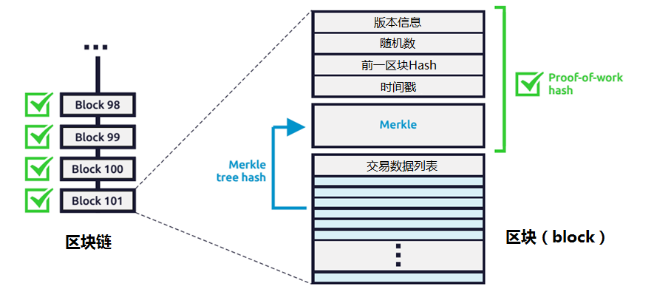
History of Database Systems
2010s: Blockchain
  A blockchain is a distributed database that maintains a continuously-growing ordered list of data blocks hardened against tampering and revision. -Wikipedia

Slide 54
End of Chapter 1

